Slide 1
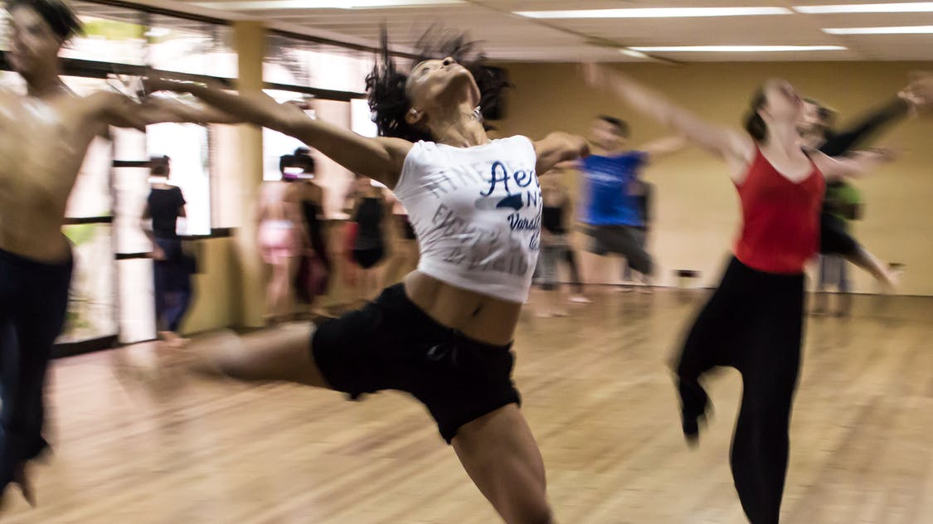
The Battle of the Neighborhoods
Where to place a new dance studio in Moscow?
Sources: https://www.pexels.com/ru-ru/

Slide 2
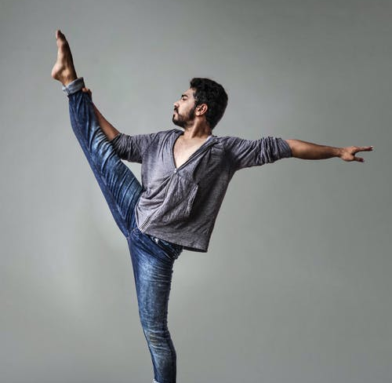
Problem Background
Sources: https://www.pexels.com/ru-ru/

Slide 3
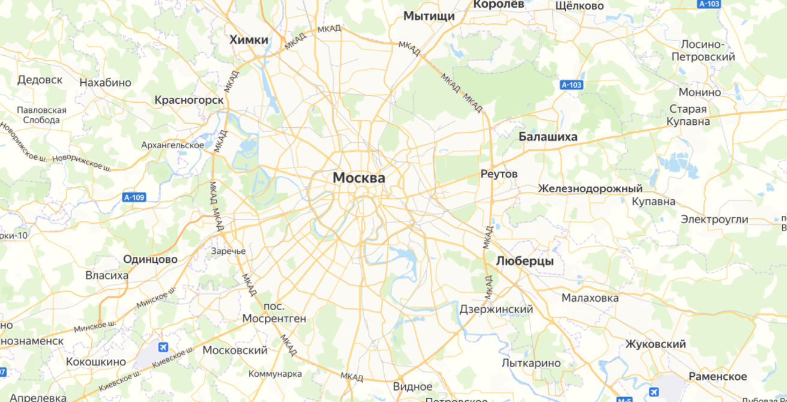
The best place for a dance studio
Key facts that should be considered:
Moscow is a large city with a developed infrastructure. This means that the market is highly competitive.
As it is highly developed city so cost of doing business is also one of the highest.
Studio should satisfy the following criteria:
1. Not located next to other studios. (gyms, yoga centers are allowed)
2. Located in a fairly populated area (that is, it will be convenient for people to visit the studio)
3. Free buildings can be taken from the cian website, in the absence of suitable places, just look at the areas
4. The place should be nearby metro (subway station, as subway is a key transport)

Slide 4
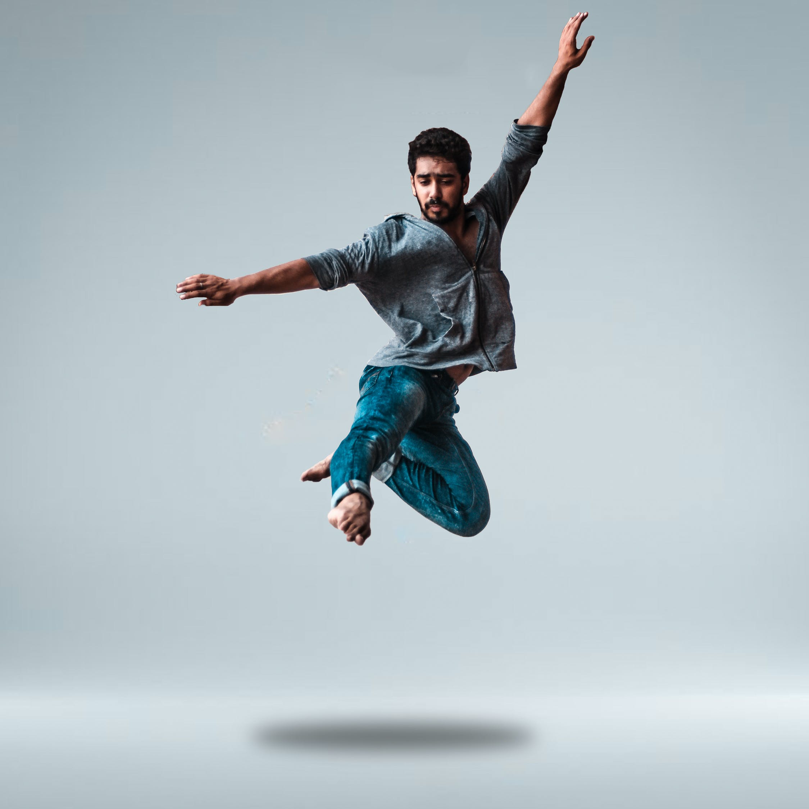
Data
Sources: https://www.pexels.com/ru-ru/

Slide 5
Data description
1
Borough (Neighborhoods) of Moscow
Moscow has a total 125 neighborhoods and its shape in GEOJSON format. In order to explore neighborhoods, we will essentially need a dataset that contains the as well as the the latitude and longitude coordinates of each neighborhood.
List of Moscow District and they Boroughs were downloaded from the page Moscow Boroughs
Shape of every Borough
Shape of the each Moscow Borough in GEOJSON format was downloaded from the page Moscow Boroughs GEOJSON
Density of every Neighborhood
Second data which will be used is the density of population dataset. We will use the data from Wikipedia (link).
Available places for rent
The data was taken from a popular in Russia web-site cian. It includes data about price, time from this place to nearby metro-station, area of a place, address (link)
List of venues placed nearby places for rent
Places for rent geographical coordinates data will be utilized as input for the Foursquare API, that will be leveraged to provision venues information for each potential place for rent. We will use the Foursquare API to explore neighbor of a place for rent in Moscow.
Name for type of Dance venues
In order not to open a new dance studio nearby existing studios we should filter available places for the absence of dance clubs nearby. From Foursquare I found venues_types dedicated to dance.
2
3
4
5
6

Slide 6
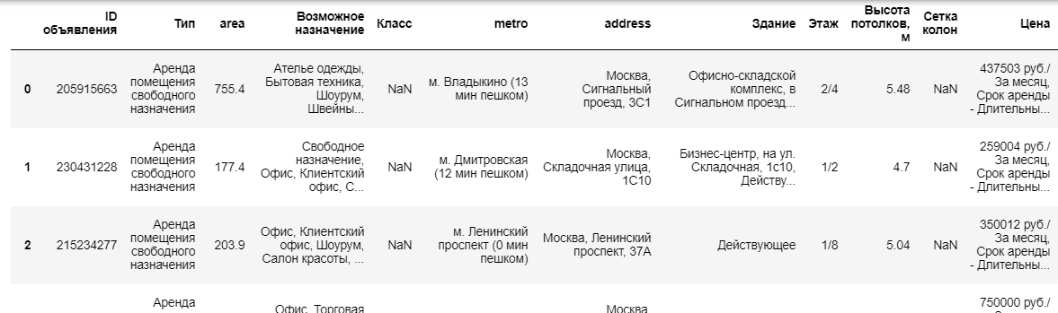
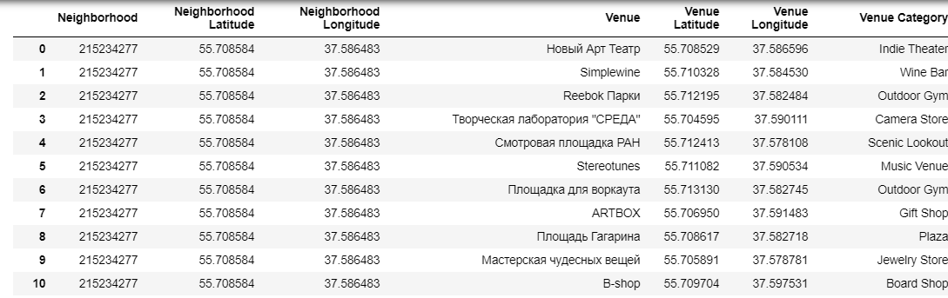
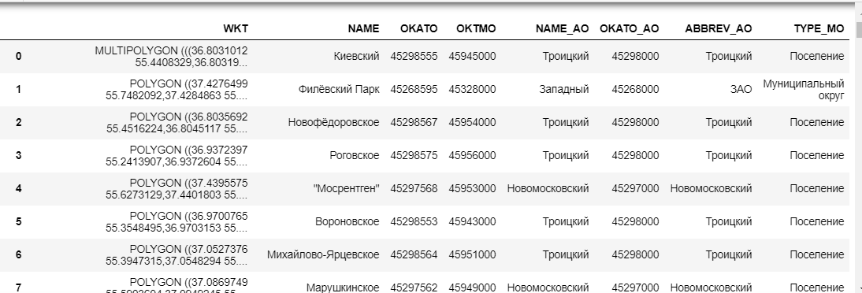
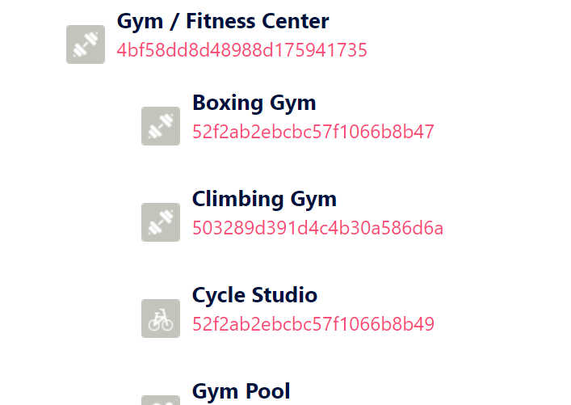
Data examples
Places for rent
Venues examples
Boroughs list
Venues type from FourSquare

Slide 7
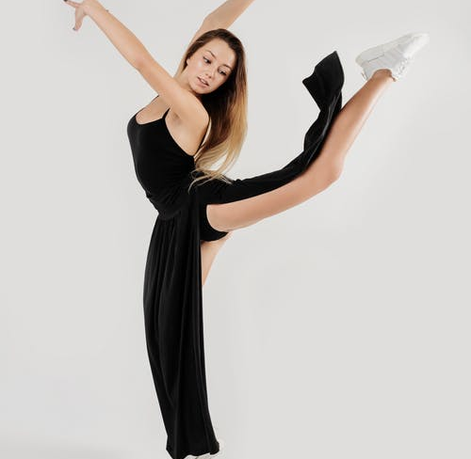
Methodology
Sources: https://www.pexels.com/ru-ru/

Slide 8
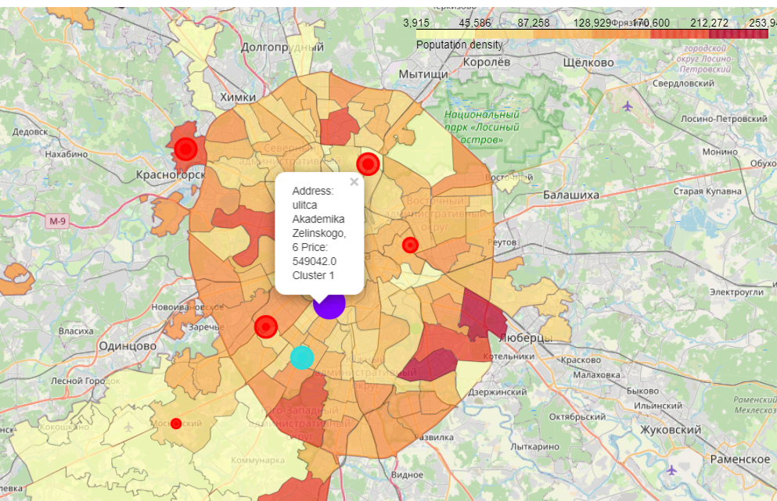
Dataframe of possible places for new studio was sorted (with the use of FourSquare were found nearby venues in radius 1500m. If in this venues were dance studio the place was excluded from consideration)
Then were made clusters of venues nearby places for rent and then they were drawn on Map of Moscow
On Map of Moscow were drawn density of population of each borough
On this map showed only places for rent that are not situated nearby dance studios.
The bigger diameter of a circle the less time you need to get to a metro station
Then were found the best suitable examples for best clusters

Slide 9

Result
Sources: https://www.pexels.com/ru-ru/

Slide 10
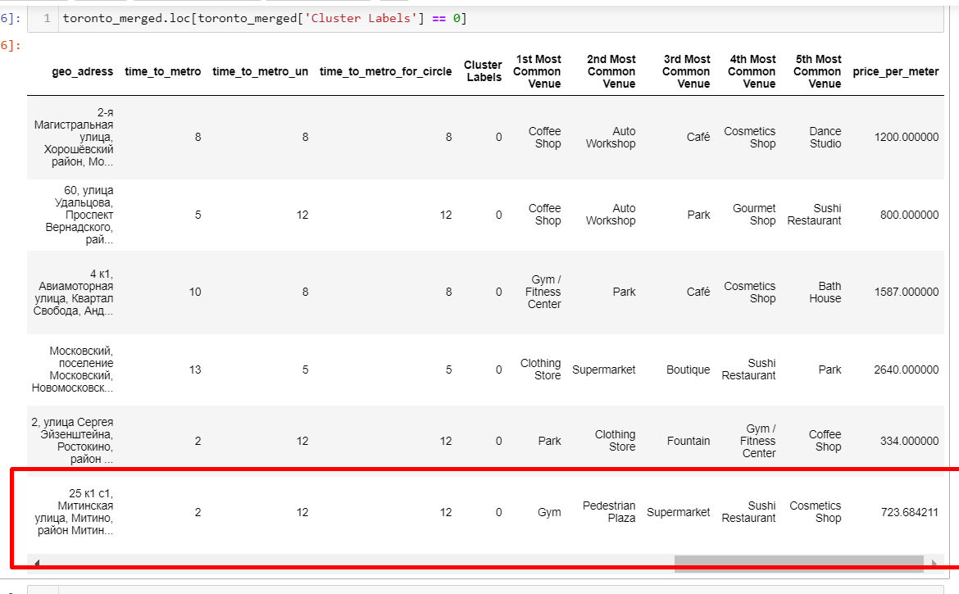
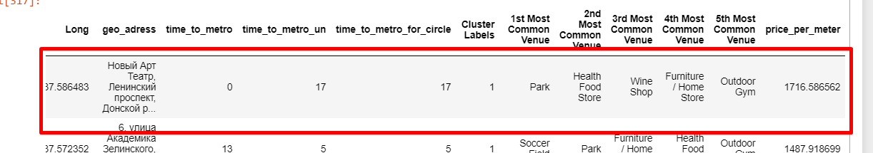
Two leaders
After examining, I have chosen two locations that meet the requirements which will assess to make a choice:
First one place. The first venue has a good description and position.
The price is good and situated nearby metro. The population density is high as it could be seen on map
Second one place. It is situated in quit popular place in center
The price is not extremely high, situated nearby metro. There is no indoor gym nearby.

Slide 11
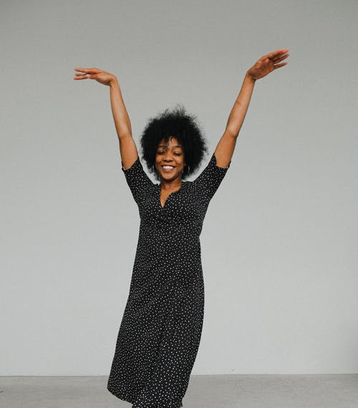
Selection
Sources: https://www.pexels.com/ru-ru/

Slide 12

Choosing the best place
Using the “Moscow map" above, I was able to explore all possibilities since the popups provide the information needed for a good decision.
Place 1 has area 152 m*m and rent cost is 110000 Rub per month. Place 1 is located in 2 minutes from metro station. Nearby venues shows that there is gym nearby. According to website of this gym there is no dance classes in this gym.
Place 2 has area 203 m*m and rent cost is 350000 Rub per month. It situated in a less populated borough. Nearby venues shows that there is now popular indoor gym and dance studio.
Based on research, Place 1 is a better choice since the extra monthly rent is worth the conveniences it provides, it has better conditions.
Sources: https://www.pexels.com/ru-ru/

Slide 13

Discussion
In general, I grateful to Coursera IBM Certification Course.
I feel this project presented me a great opportunity to use knowledge
I have created my first project working during and I a bit proud of it, cause it helped me to believe in myself.
Sources: https://www.pexels.com/ru-ru/

Slide 14

Conclusion
This project has shown me a practical application to resolve a real situation that has impacting personal and financial impact using Data Science tools.
Sources: https://www.pexels.com/ru-ru/

Slide 15

Thank you!
Sources: https://www.pexels.com/ru-ru/

